Slide 1



News Category Classifier
Hamza Parekh, Carlos Olea, Matthew Li

Slide 2
Goal
The goal of the project was to build a Neural Network Model that could predict the category for a given article.
Steps:
Web Scraping
Data Analysis
Data Processing
Model Building
Model Optimization

Slide 3
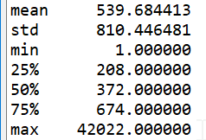
Original Data
Since we were web scraping to get our data, our data set has changed.
From only Time articles to also including The New York Times articles
From initial 4,500 articles ➨ ~30,000 articles
Data: 6.5MB ➨ 70.78MB
Three categories:
Politics
Health
Technology

Slide 4

Web Scraping
Wanted to use API to get the news articles, signed up for New York Times API but never received key.
Two methods:
Time News: used BeautifulSoup4 to scrape as it had a static amount of links per category page.
New York Times: used Selenium webdriver with BeautifulSoup4 as it had a dynamic amount of links to articles.

Slide 5
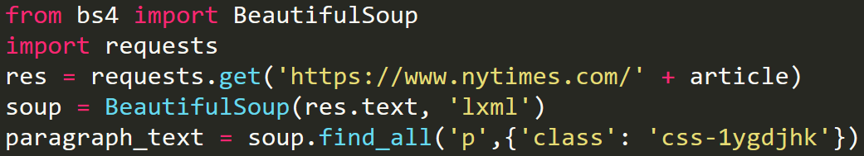
Article Scraping
Article scraping was similar for both sites:
Analyzed pages and found the trend to allow us to scrape repeatedly.
HTML tag you want to scrape
Attributes such as class, id, etc.

Slide 6
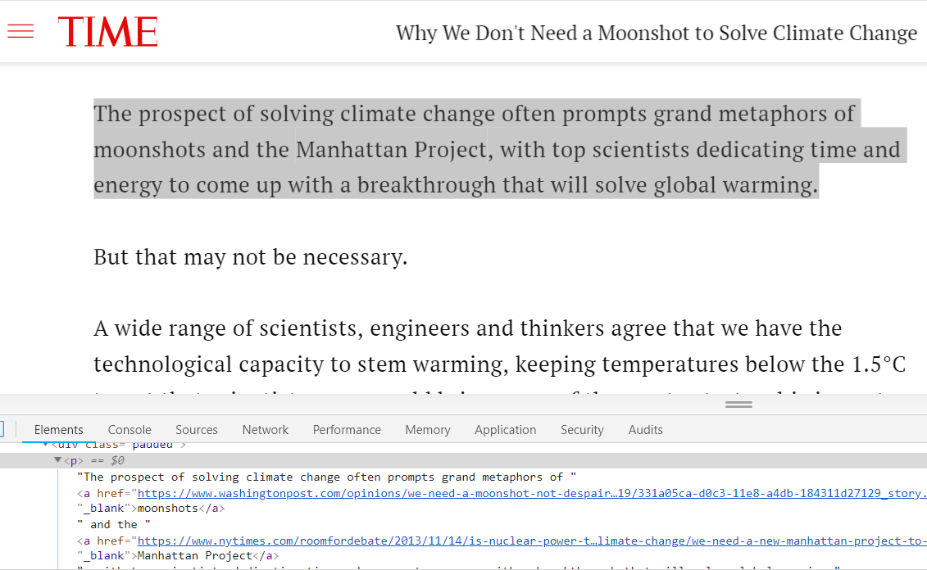

Slide 7
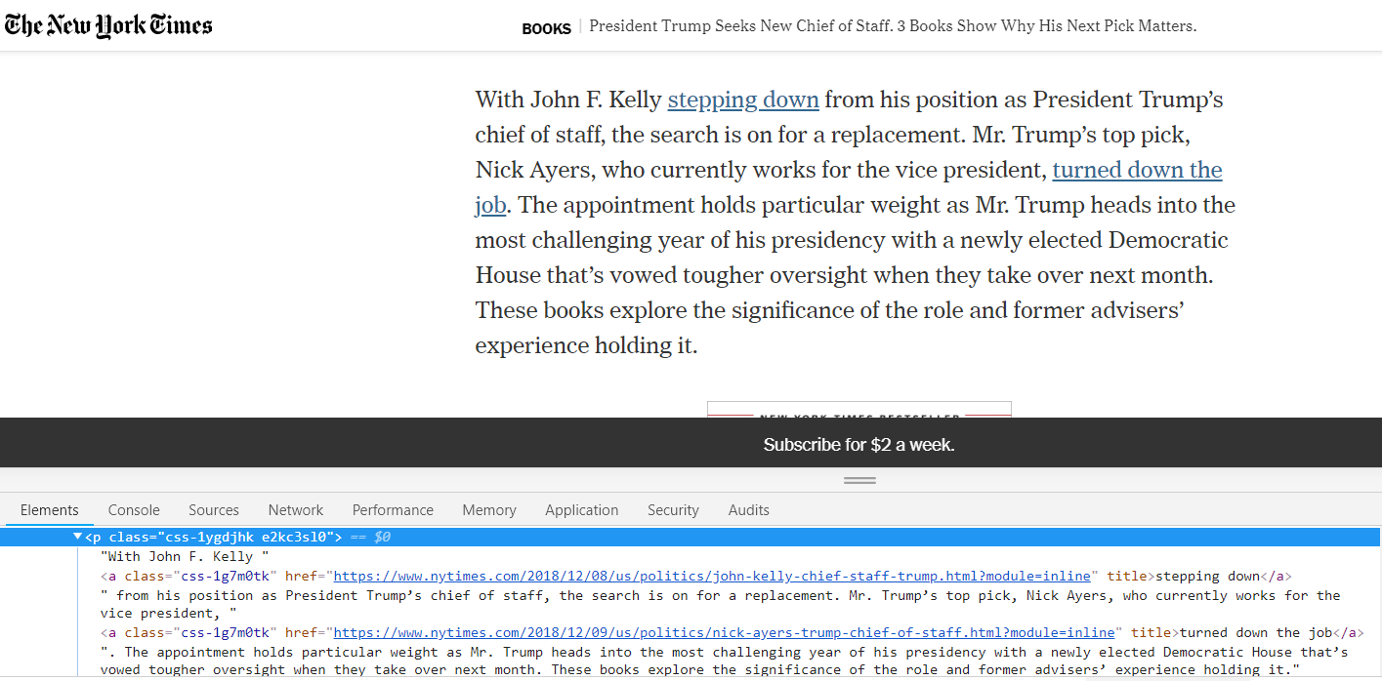

Slide 8
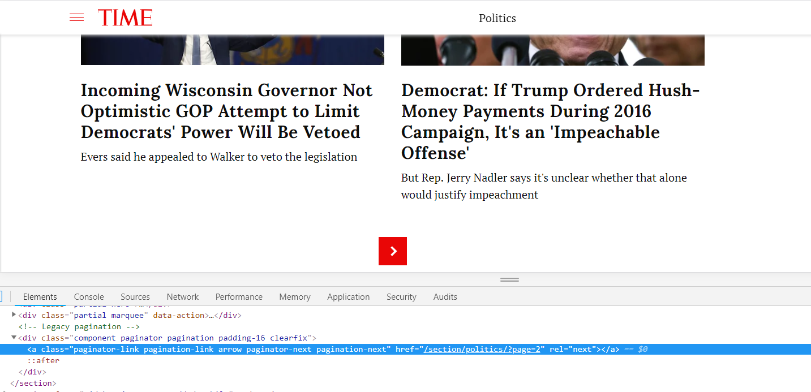
Time.com Category Scraper
Collect all links on page and then go to link that is specified by button.

Slide 9
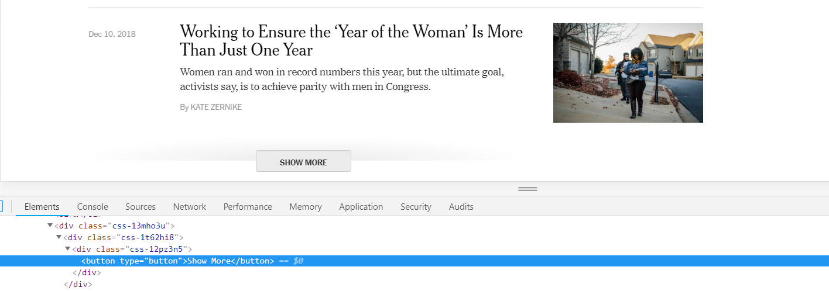
NY Times Category Scraper
Use Selenium webdriver to simulate clicking up to a certain point and then grab all of the links to the articles.

Slide 10
Web Scraping Issues
Ran into problems:
Lost Internet connection once and had to restart scraper
Was blocked by Time.com server:
ConnectionError: ('Connection aborted.', ConnectionResetError(10054, 'An existing connection was forcibly closed by the remote host', None, 10054, None))

Slide 11
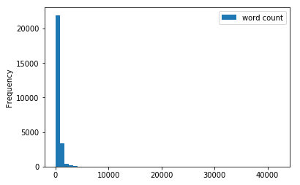
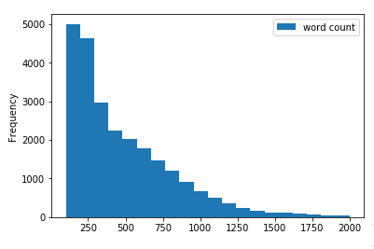
Data Analysis
Filtered Frequency between 100 to 2000 words
Overall

Slide 12
Data Processing
Machine Learning models require equal size amongst all of the training and testing data
400 word input size as this was the close to the 50% percentile
100 word base cut off point for testing data
Stripped all punctuation and lowercase all words
Padded all articles that had a word count lower than 400 with incomprehensible “words”

Slide 13
Example of first 400 words
its both incredibly easy and somewhat difficult to describe nintendos fighting crossover game series super smash bros in short its a battle royale game that pits characters from different gaming franchises against each other dig deeper into the series latest entry super smash bros ultimate and youll find more than a fighting game thats fun for parties youll get a tour through nintendos gaming history shared via its new story mode as well as a game that caters to every type of player from the casual newcomer to the competitive veteran super smash bros ultimate brings back every playable character from the series past adds some new ones and spares little expense when it comes to giving fans what they truly want from a game where a mega man can knock sonic the hedgehog into a black hole created by mario sure the premise ridiculous fights between your favorite characters is the same but with such a winning formula why fix what aint broken heres the gist super smash is a fighting game series the goal of which is to knock your fellow combatants off themed stages and into oblivion players pick one of a stable full of video game characters like princess peach sonic or link and duke it out in a variety of arenas filled with bombs laser guns flowers and the occasional giant dog among the nearly available weapons and other the original super smash debuted in and featured a dozen fighters pulled from nintendos library of characters super smash bros ultimate the fifth entry in the franchise has a roster over fighters deep that includes every character from the previous games plus some new contenders from nintendo and other participating developers nintendo is also planning to release five paid downloadable content packs each with a new fighter stage and accompanying music the games breadth of choice is impressive and youre bound to recognize more than a handful of characters each with their own signature moves and special abilities save for the few characters with identical fighting styles but different looks like daisy and peach new to super smash bros ultimate is the inclusion of a world of light story mode wherein you explore a stylized board game of a world as the alien kirby sole survivor of an assault by the games antagonist as you defeat evil versions of the games fighters and solve simple puzzles

Slide 14

An issue of semantics
Machine learning models operate using numeric inputs, requiring strings to be somehow encoded.
However, a semantic representation(one preserving the meaning) of a word is generally difficult to achieve.
These problems can be addressed with a proper embedding and encoding

Slide 15
Encoding Data (word embedding)
Word are encoded to unique numbers, then converted into vectors for embedding.
Word Embedding provides context as patterns and regularities become inbuilt in each vector that represents a word
https://projector.tensorflow.org/
The model learns the embedding along with the prediction

Slide 16
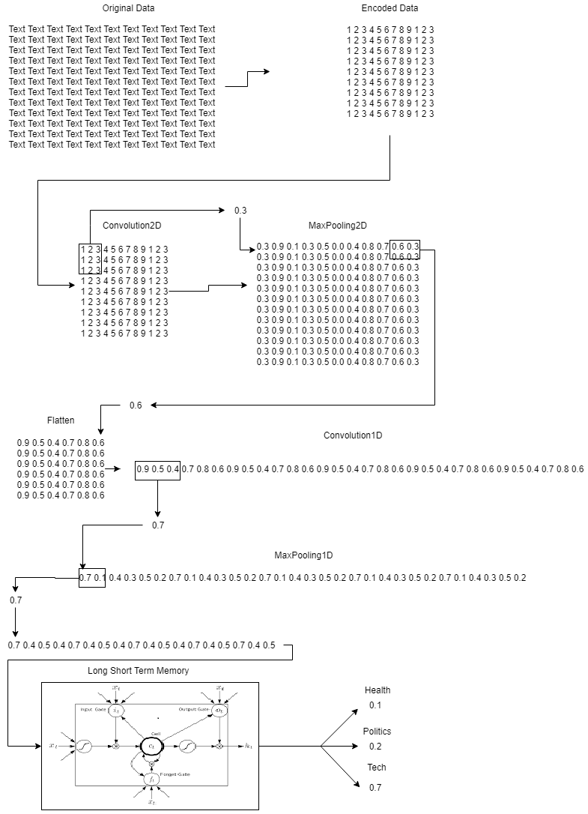
Model Overview

Slide 17
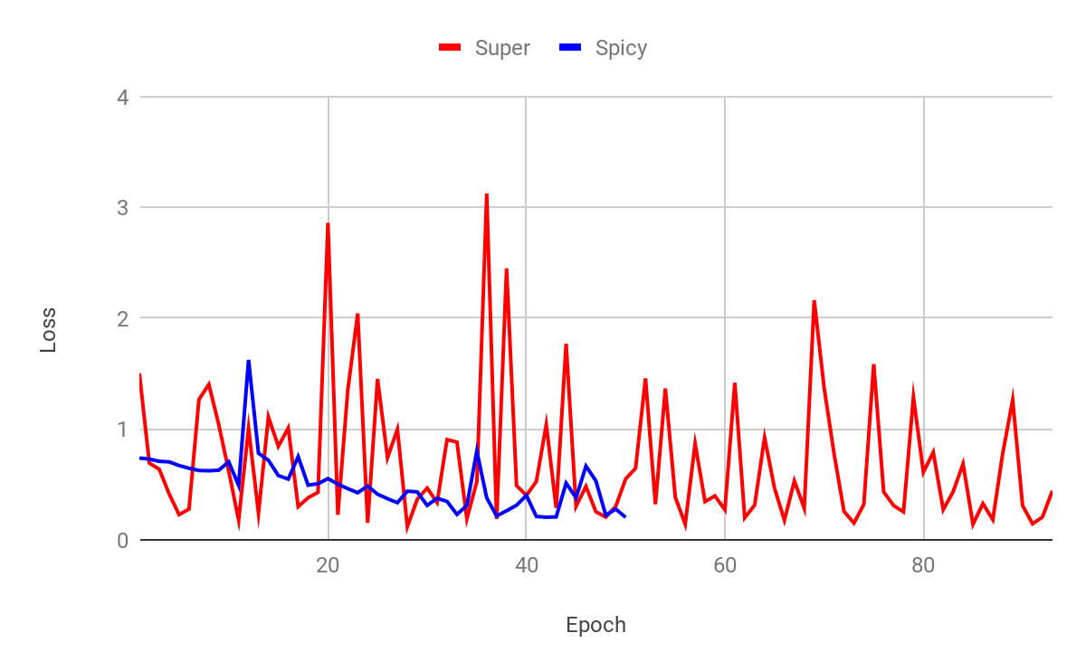
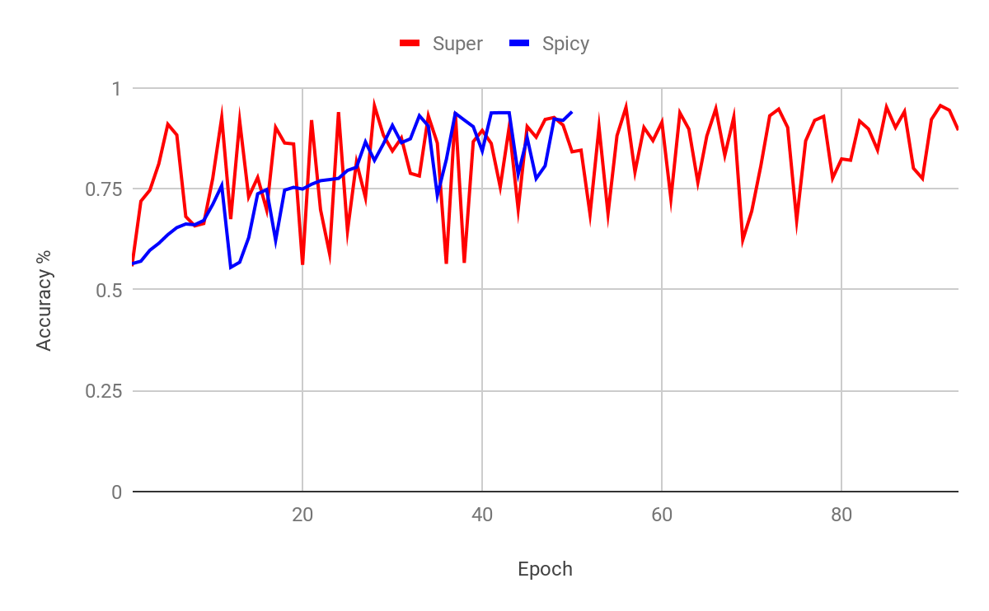
Validation Loss
Validation Accuracy

Slide 18
Demo

Slide 19
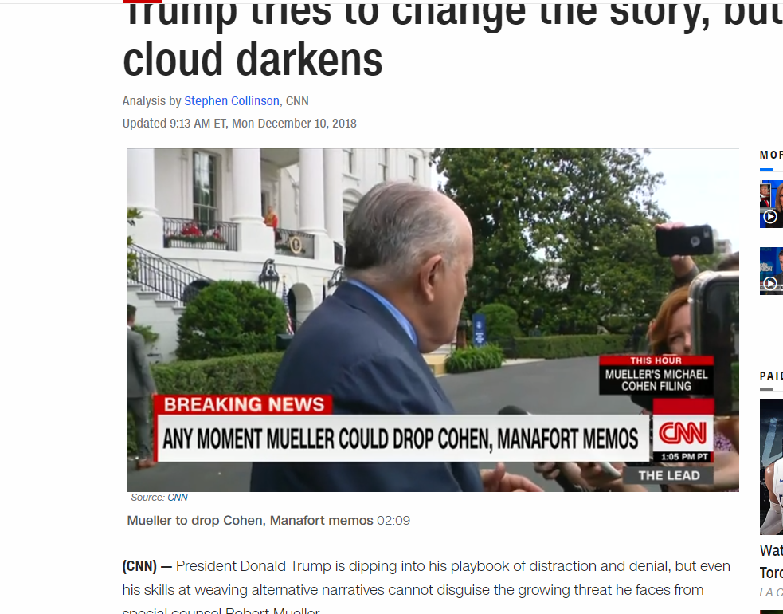
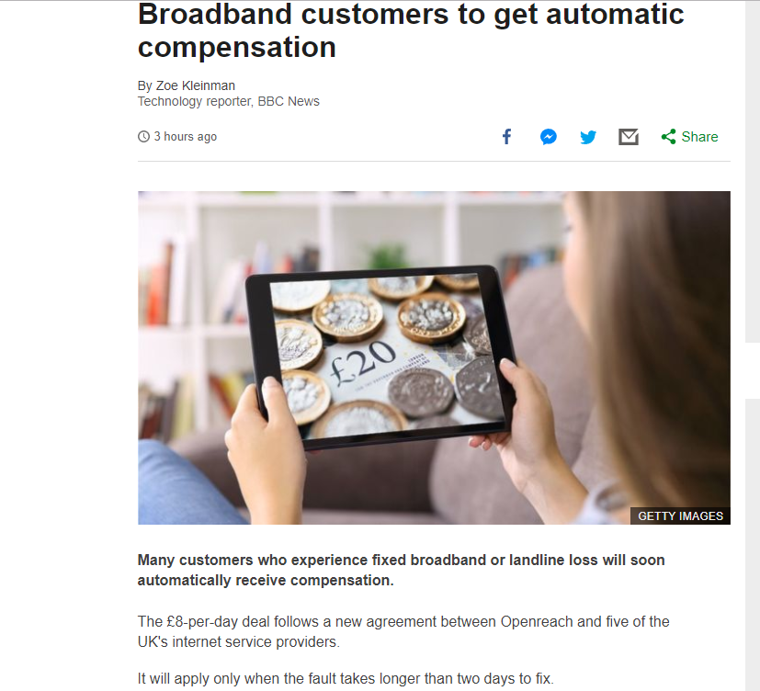
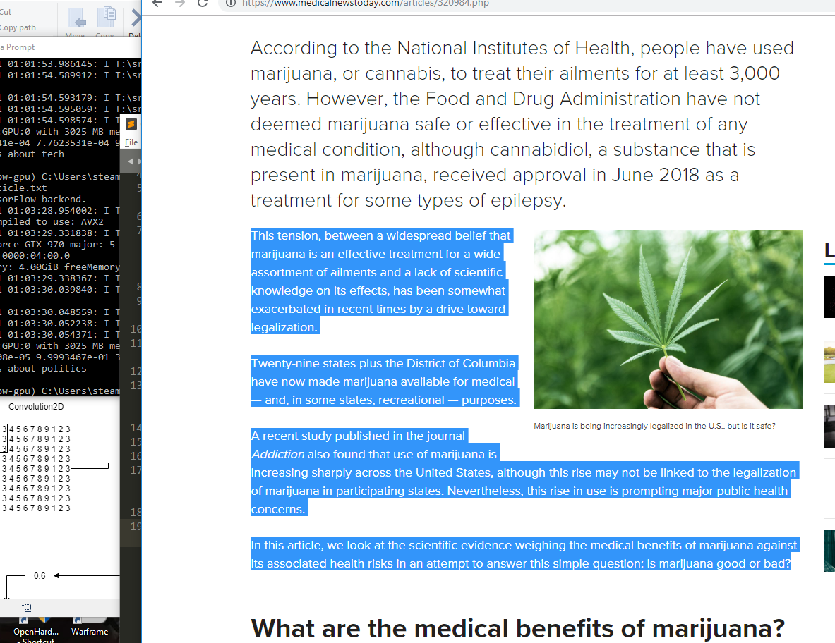
Find an article of type health/politics/tech

Slide 20
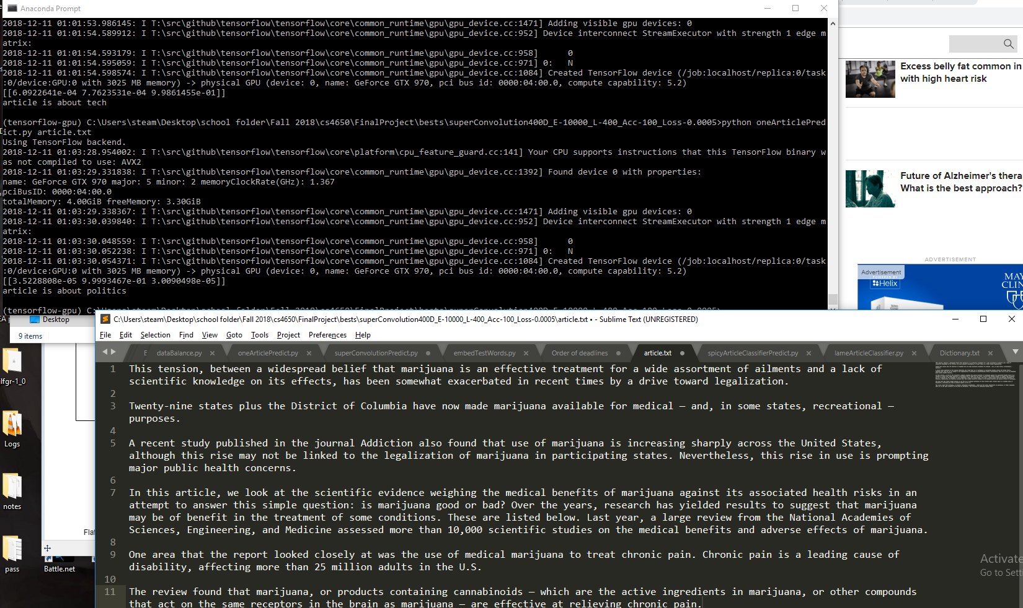
Save to a text file

Slide 21
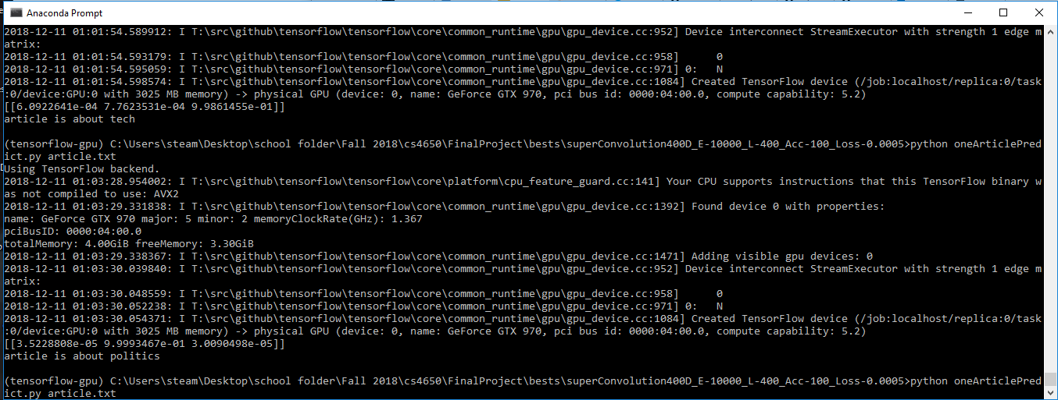
Run oneArticlePredict.py with article path as an argument

Slide 22
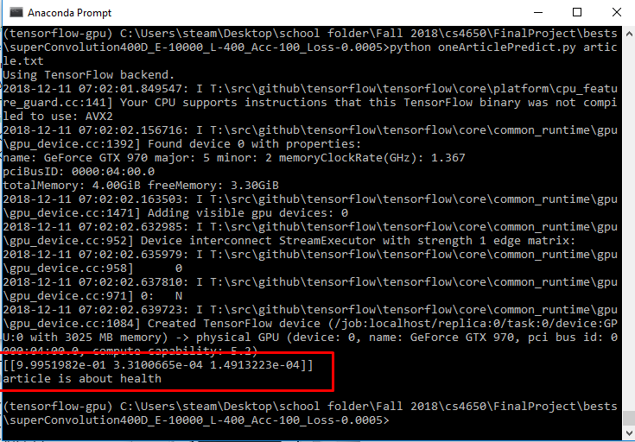
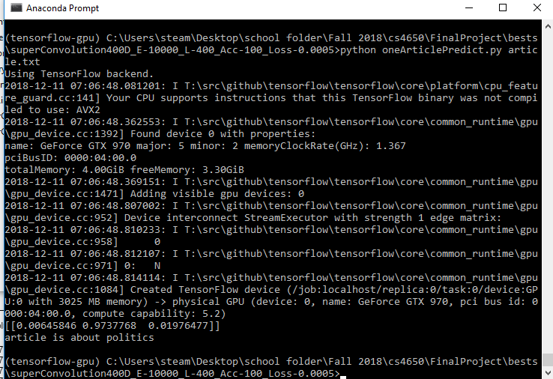
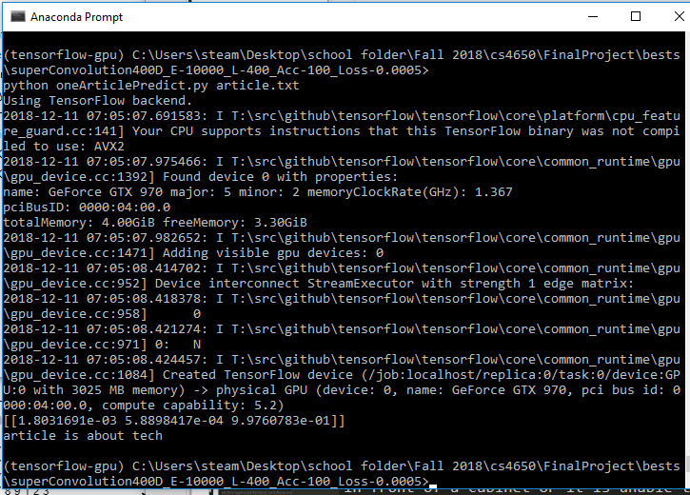
Obtain prediction result

